Slide 1
2023
QUIVIRA COUNCIL
KERNEL TRAINING

Slide 2
Unit and Council Impact
SCOUTING VALUES
Scouts learn to earn their own way
Scouts learn responsibility
Scouts learn perseverance
Salesmanship
Communication
Self Confidence
Enhance Scouting programs
Provide needed equipment
Reduce program costs

Slide 3
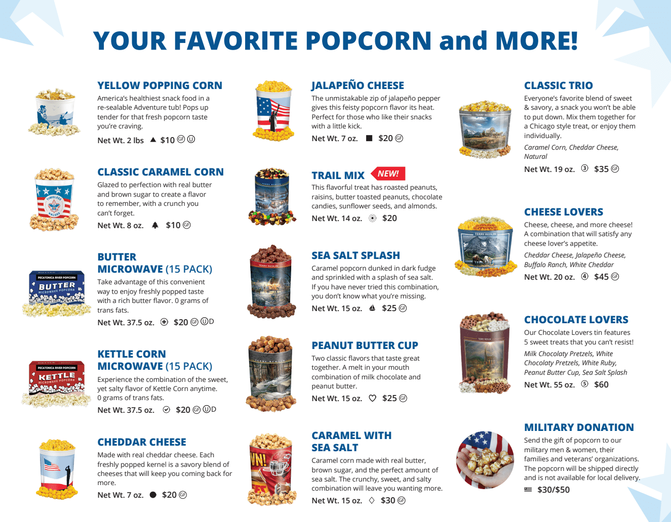

Slide 4
Important Dates
FIRST DISTRIBUTION SCHEDULE
Sept 1 - Show & Sell Orders due in Pecatonica River system
Sept 21 - Show & Sell Distribution for White Buffalo and South Winds
Sept 22 - Show & Sell Distribution for Kanza and Pawnee
Sept 23 - Show & Sell Distribution for Osage Nation
Sept 22 - Popcorn Sales Begin
SECOND DISTRIBUTION SCHEDULE
Oct 29 - Popcorn Orders Due in Pecatonica River system
Nov 16 - Take Order Distribution for White Buffalo and South Winds
Nov 17 - Take Order Distribution for Kanza and Pawnee
Nov 18 - Take Order Distribution for Osage Nation

Slide 5
UNIT COMMISSIONS
Show & Sell and Take Order Sales
Base Commission – 31% (Units facilitate their own prizes and handle any credit card fees)
+1% Units attend District’s Kernel Training – in person or via zoom (Total 32%)
+1% Unit has average of $250 per Scout, based on July 31, 2023 Membership. * (Total 33%)
OR
+2% Unit has average of $400 or more, per Scout, based on July 31, 2023 Membership. * (Total 34%)
*This would be an amount that is locked in per Unit. Therein, any new youth recruited during fall 2023, would decrease that average per scout youth.
IMPORTANT – track and report sales by Unit
Ex. July Registered Youth = 10 youth, average $250 in sales each or $2,500 in total sales. If the Unit recruits 10 youth, now having 20 registered youth, the goal would still be $2,500, but now the youth only need to average $125 in sales for the unit to earn the additional 1%.
Online Sales
30% Commission to the Unit for online sales with FREE SHIPPING on all orders

Slide 6
COUNCIL INCENTIVES
Popcorn Sales Level |  | Program Fee Incentive Credit
$200 |  | $5
$300 |  | $10
$400 |  | $15
$500 |  | $20
$600 |  | $25
$700 |  | $30
$800 |  | $35
$900 |  | $80
$1,250 |  | Scout aged appropriate reward valued at $40
$2,500 |  | Credit for half of the early bird camp fee for 2024 Quivira Council Camps.
We want to thank the Scouts that go the extra mile by rewarding them for hitting $900 in sales and giving them full credit for their program fee at recharter or membership renewal time

Slide 7
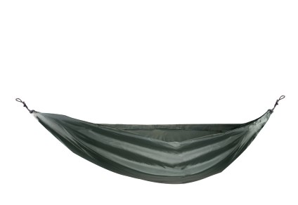
New Prize Options for Pack Sellers!
Pack Option 1 - Victorinox Bear Necessities Swiss Army Knife
Pack Option 2 - BSA Single Person Hammock with Straps
Every Scout that reaches/surpasses $1,250 in total sales will receive this Council level prize.
For Pack level Scouts, their choice of a camping rated hammock or, for Bear Scouts or higher, a Swiss Army Knife. Any Scout that qualifies can also choose a $40 Amazon gift card for their Council prize instead of a knife or hammock.
Notes:
Unit will be responsible for turning in list of earners to Council by October 31, 2023.
Council will issue knives to Unit Leaders, with the expectation that Unit Leaders present them to youth with parent/guardian present.

Slide 8
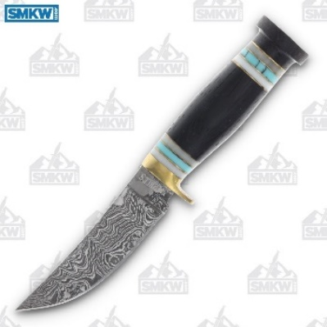
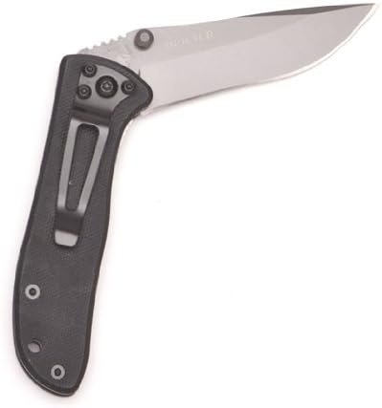
Prize Options for Troop/Crew/Ship Sellers!
Troop Option 1 - 10″ Damascus Turquoise Hunter Fixed Blade
Troop Option 2 - CRKT Drifter EDC Folding Pocket Knife
Every Scout that reaches/surpasses $1,250 in total sales will receive this Council level prize.
Any Troop Scout that qualifies can also choose a $40 Amazon gift card for their Council prize instead of a knife.
Notes:
Unit will be responsible for turning in list of earners to Council by October 31, 2023.
Council will issue knives to Unit Leaders, with the expectation that Unit Leaders present them to youth with parent/guardian present.
It is recommended that Units create a Sheath Knife policy if they intend to allow youth to carry/use sheath knives during Unit events (example policy is posted to the popcorn page at www.quivira.org/popcorn-sale/).
Currently, sheath knives are NOT ALLOWED at Quivira Council District or Council activities.

Slide 9
MORE COUNCIL INCENTIVES
Top Seller Awards
Council Top Seller** $300 Amazon Gift Card
Top Seller from each District $150 Amazon Gift Card
Next Top 10 Sellers (all Districts) $100 each - Amazon Gift Card
Next Top 10 Sellers (all Districts) $50 each - Amazon Gift Card
Next Top 30 Sellers (all Districts) $25 each - Amazon Gift Card
**Note: Council top seller is excluded from District top seller awards

Slide 10
PR POPCORN
WINNER'S CIRCLE
ONLINE SALES INCLUDED!
For every $3,000 sold a Scout will have their choice of prize from Pecatonica River's "Winner Circle". Unit kernel will enter their Scouts into the Winner Circle on the Pecatonica website.

Slide 11
WHERE TO SELL
Show & Sell
Set up in high traffic area
Popcorn is ordered in advance on consignment from Council
Show & Deliver
Combine Show & Sell and Take Order
Popcorn is taken door to door & sold on the spot
Take Order
Traditional way of going door to door
Popcorn is delivered after the sale
Online Store
Customers can support all across the country
Each Scout gets credit for sales

Slide 12
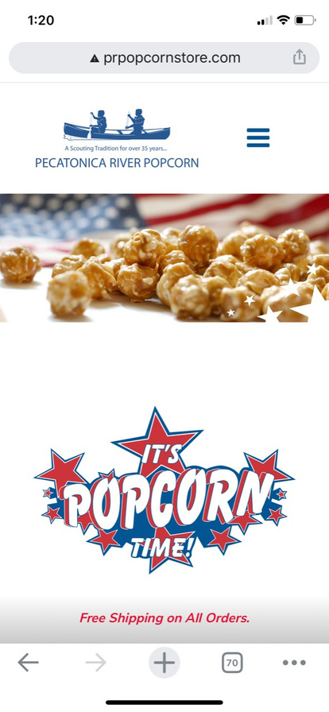
ONLINE STOREFRONT
PRPOPCORNSTORE.COM
60% of every purchase goes back to Scouting – 30% to the Scout's Unit and
30% to the Council in their name
FREE SHIPPING
No deliveries to worry about - all ships from PRP
ALL SALES COUNT TOWARDS PRIZE LEVELS
Personable email can be sent to family & friends with customized video message

Slide 13
PRPOPCORNSTORE.COM
Opens: September 22nd
Closes: November 20th

Slide 14
ONLINE STOREFRONT
Customers can search by Scout name, Council or unit if they arrive at the store without the seller id
Store will display the Scout Name at the top of the page, so the consumer knows who they are supporting.
Updated images show what bundles look like so there is no confusion on packaging.
Online sales will be live in Scout Boss, Kernel Tracker, and MyPRPopcorn (PRP no longer has to process to get them to show up)
Notification emails will no longer be sent as the data will be live in the system

Slide 15
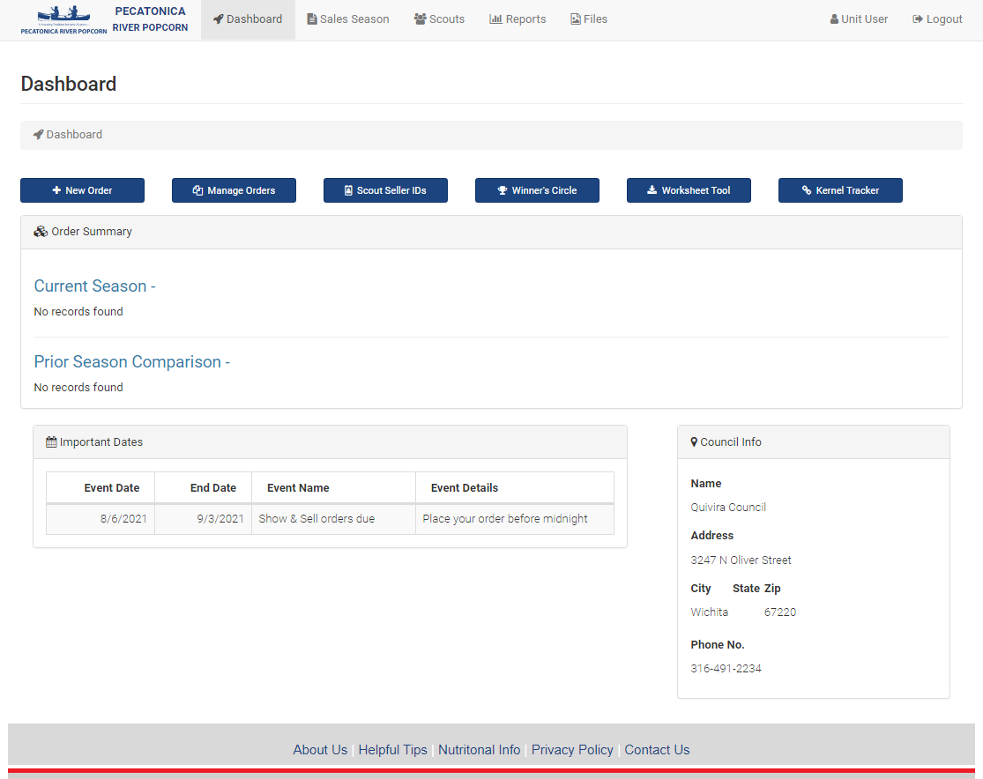
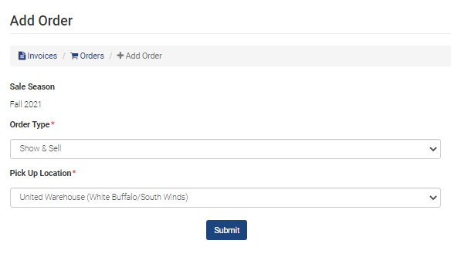
PLACING YOUR SHOW & SELL ORDER
1. From your dashboard, click on New Order
2. Select Show & Sell under Order Type and appropriate Pick Up Location for your District and click submit
3. Enter the number of cases for each product type and click submit/update at bottom of screen

Slide 16
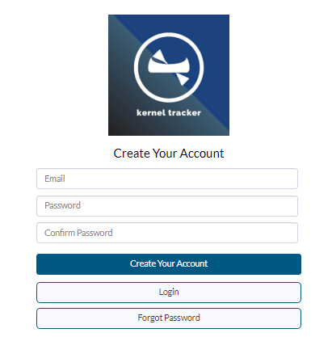
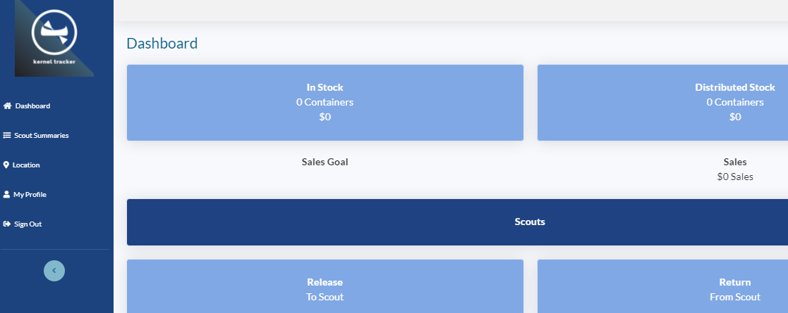
KERNEL TRACKER TOOL
1. From your dashboard click on Kernel Tracker
3. Click on dashboard to view your product stock and distribution to scouts
2. The first time you log in, you will need to create your account

Slide 17
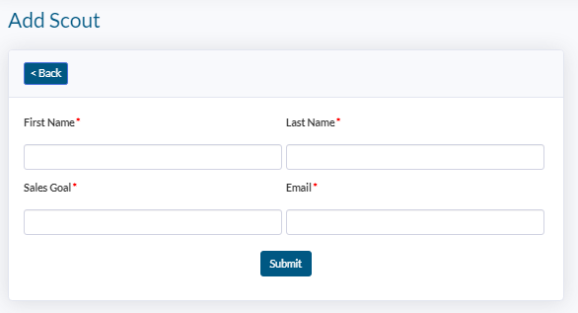
ENTER SCOUT INFO FOR NEW SCOUTS
1. While in Kernel Tracker, click on Scouts
2. Click on Add Scout
3. Enter the Scout's information and click submit, repeat for all scouts

Slide 18
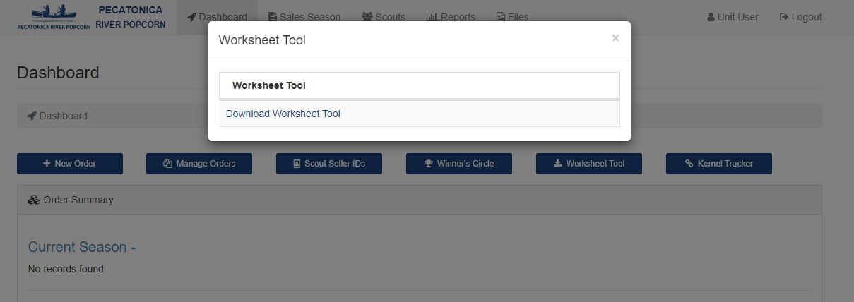
WORKSHEET TOOL
1. From your dashboard click on Worksheet Tool
3. Save Excel Worksheet and populate with your Unit/Scout info. You will use this tool at the end of the sale to submit your scout totals to Council for awards
2. Click download worksheet tool

Slide 19
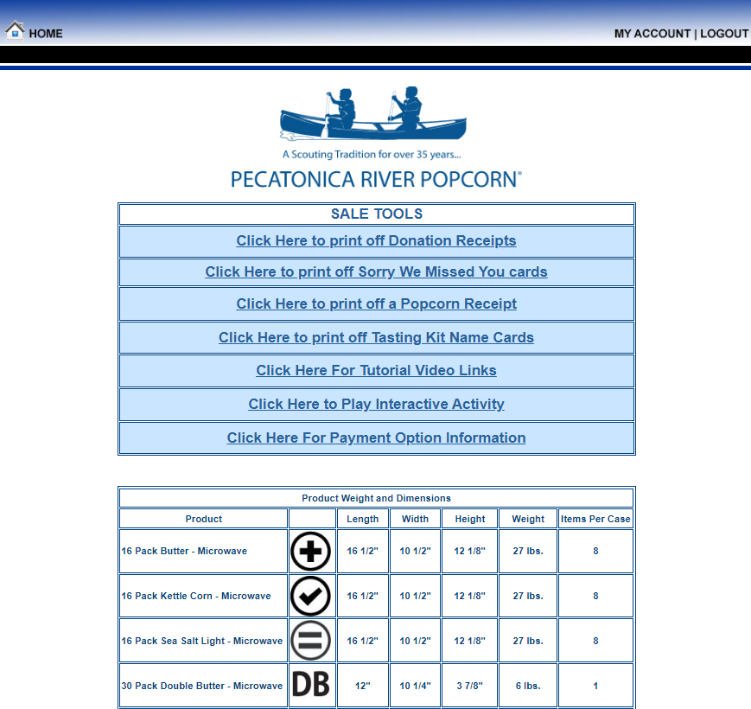
HELPFUL TIPS

Slide 20
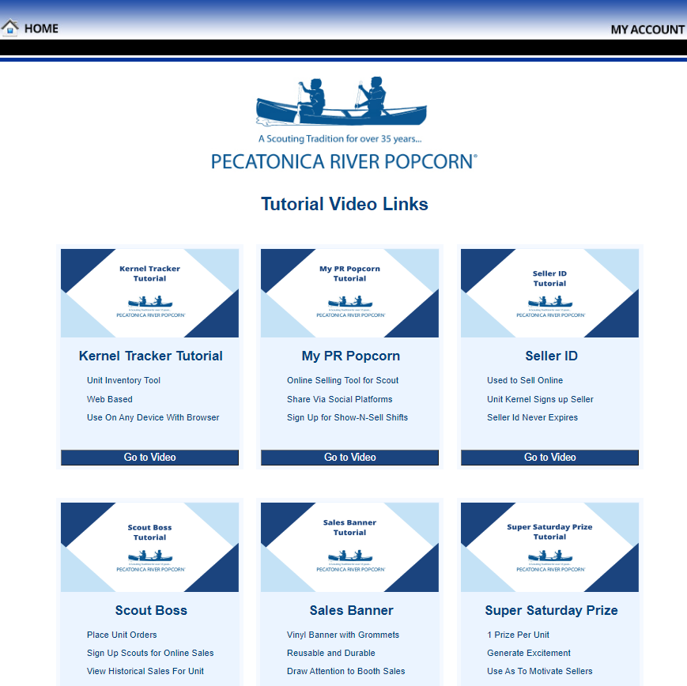
TUTORIAL VIDEO LINKS
2
1

Slide 21
TECHNICAL SUPPORT & SERVICES
KERNEL TRACKER TOOL
SCOUT BOSS
WEB BASED (NO APP STORE)
LINK AVAILABLE ON UNIT DASHBOARD
LIST SHOW-N-SELL LOCATIONS SHIFTS
MANAGE SIGN UPS FOR S&S SHIFTS
LIMIT SCOUTS
REMOVE SCOUTS
CLOSE LOCATION
VIEW HISTORICAL SALES
SIGN UP SCOUTS FOR ONILNE SALES
VIEW ONLINE SALES
ENTER SCOUTS INTO WINNERS CIRCLE
MYPRPOPCORN TOOL
SQUARE
ONLINE SELLING APP FOR SCOUT
SHARE VIA SOCIAL PLATFORMS
TRACK SALES PROGRESS
SIGN UP FOR SHOW-N-SELL SHIFTS
INCREASE SALES
ACCEPT CREDIT CARDS ANYWHERE
UPLOAD PRODUCT MIX FROM PR WEBSITE

Slide 22
TECHNICAL SUPPORT & SERVICES
SALES TUTORIALS www.pecatonicariverpopcorn.com/Tutorials.html
Kernel Tracker
My PR Popcorn
Seller ID
Scout Boss (unit)
Sales Banner
Super Saturday Prize
Bullet Board
Envelopes
Tote Bag
Tasting Kit
Sales Flyer
Take to Work Tent
Door Hanger
PR Popcorn Support email:
pops@prpopcorn.com

Slide 23
UNIT SWAPS
Giving Unit
Post on Quivira Council Popcorn Facebook page details of product you have available to swap or contact your District Kernel if you are not on Facebook
When contacted by Unit who needs your product, send email to kernel with quantities (cases and containers) of each product.
Confirm date/location of product swap via email
Once product is swapped, forward the details in an email to QCpopcornswaps@gmail.com and CC the Unit’s kernel receiving the popcorn.
Adjustments will be made to each unit’s popcorn invoice statement
to reflect the product transfer within Pecatonica River’s System.

Slide 24
QUIVIRA COUNCIL POPCORN FACEBOOK PAGE AND COUNCIL POPCORN WEBSITE
Stay connected with our Quivira Council Popcorn Facebook page and the Council website:
https://www.facebook.com/groups/QuiviraCouncilPopcorn/
https://quivira.org/popcorn-sale/

Slide 25
UNIT RETURNS TO COUNCIL
Full cases** of product may be returned to the Council during the following dates/times:
Friday, October 20 from 11:00am-1:00pm and 4:00-5:30pm
Friday, October 27 from 11:00am-1:00pm and 4:00-5:30pm
**Note:
Units may not return more than 10%
of your initial show and sell order
Chocolate items may NOT be returned

Slide 26
Kanza District:
Shanna Miller – District Kernel | 785-623-3972 | smigcowgirl@yahoo.com
Luke Zimmerman – District Executive | 316-207-8116 | luke.zimmerman@scouting.org
Distribution Warehouse | Midwest Energy | 1025 S. Patton Rd., Great Bend, KS
Osage Nation
Trystan Thompson – District Kernel | 620-750-0197 | tryssiet@gmail.com
Stacey Wood – District Associate | 620-205-8118 | stacey.wood@scouting.org
Distribution Warehouse | Cleaver Farm | 208 W 21st, Chanute, KS
Pawnee District
Reagan Sprow – District Kernel | 402-217-5368 | reagansprow@gmail.com
Luke Zimmerman – District Executive | 316-207-8116 | luke.zimmerman@scouting.org
Distribution Warehouse | City Beverage Co. | 2 S. Kirby, Hutchinson, KS
South Winds District
Tammie Smith – District Kernel | 316-650-3617 | smith25tammie@hotmail.com
Alex Schmitt – District Executive | 620-708-1637 | alex.schmitt@scouting.org
Distribution Warehouse | United Warehouse | 907 E. 45th St. N., Wichita, KS
White Buffalo District
Sherri Hamilton – District Kernel | 316-304-1337 | wbpopcornkernel@hotmail.com
Jenny Jackson – Co-District Kernel | 316-250-6317 | jacksonjenb@gmail.com
Michael Redondo – District Director | 316-617-4488 | michael.redondo@scouting.org
Distribution Warehouse | United Warehouse | 907 E. 45th St. N., Wichita, KS
COUNCIL & DISTRICT KERNEL CONTACTS

Slide 27
STOREFRONT TRACKING
Google Form

