Slide 1

MAY MEMBERSHIP ROUNDTABLE

Slide 2
Topics:
  IYOS
  Organizational Tools
  Event Planning
  Recruitment Strategies
    Before School Starts
    Unit Goals
    Open Houses
    Before the Recruitment
      Be Ready for the Beast
      School Access
      Membership Kickoffs
      Checking EVERY Box
      Resources 101 (MEMBERSHIP SCHOLARSHIPS, Program)
    The Recruitment
    After The Recruitment
    Other Resources
  Parental Engagement
  Self-Assessment & Improvement
  Questions?

Slide 3
THE IMPORTANCE OF RECRUITMENT & RETENTION
What effective strategies contribute to an active Scouting community?
Consistent membership growth helps unit vitality and program quality!
Recruitment is necessary, but retention is critical!
Notes:
Key Points:
1. Emphasize the critical role of recruitment and retention in sustaining and growing Scouting programs.
2. Highlight how effective strategies contribute to a vibrant and active Scouting Community.
3. Discuss the impact of consistent membership growth on unit vitality and program quality.

Slide 4
UNDERSTANDING THE
IDEAL YEAR OF SCOUTING
Aaron Breitenbach, White Buffalo District Chair
The Ideal Year of Scouting forms focus on 4 key areas: Planning & Budget, Membership, Program, and Volunteer Leadership. Each Unit should FULLY complete the new Ideal Year of Scouting (IYS) form. This monthly guide of activities that will lead the unit towards the Gold Level of Journey to Excellence (JTE).
WHY do the Ideal Year of Scouting?
  Incredibly healthy and worthwhile – self-assessment is necessary!
  Benefits you and your unit!
Do it sooner rather than later!
Notes:
Key Points:
1. Explain the purpose and benefits of the Ideal Year of Scouting (IYOS) worksheet in planning a successful Scouting year.
2. Demonstrate how to accurately complete the worksheet to align unit goals with available resources.
3. Discuss how the IYOS worksheet supports both recruitment and retention by providing a clear roadmap for the year.

Slide 5
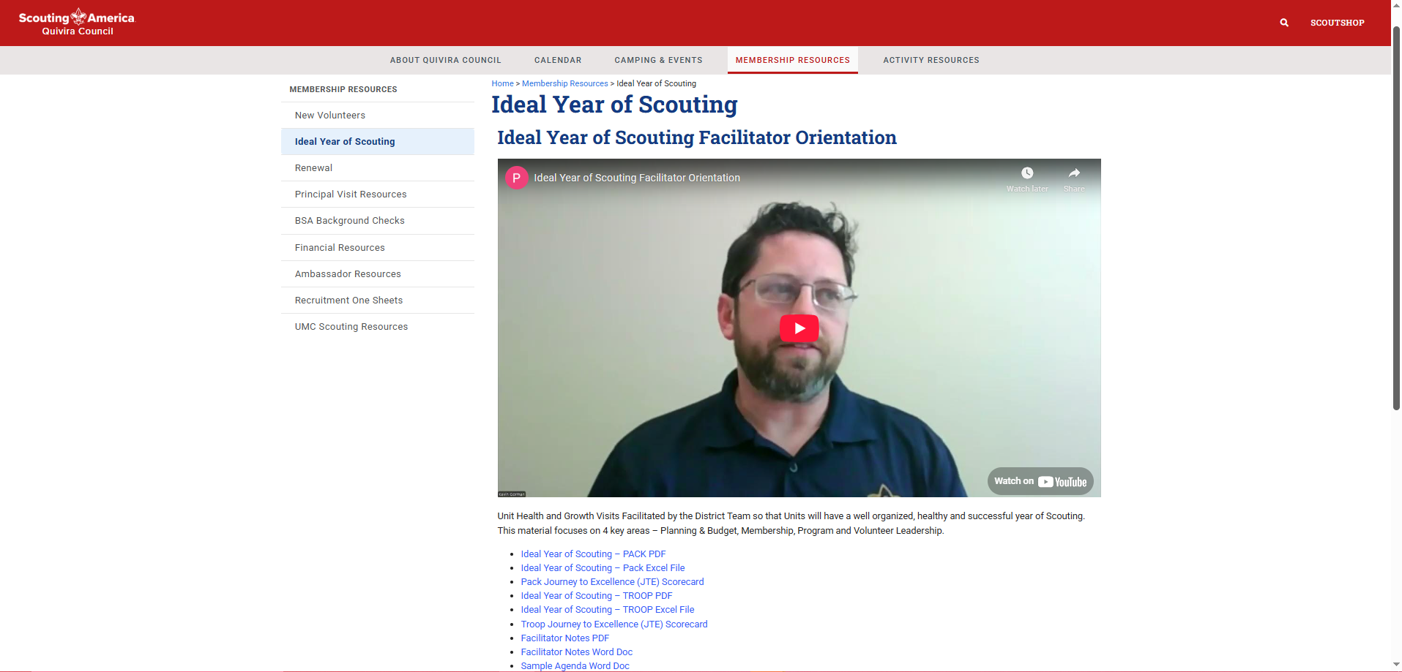
WHERE TO FIND THE IYOS FORM
Notes:
Quivira's website > Membership Resources > Ideal Year of Scouting tab

Slide 6
WHAT TO DO FOR AUGUST PROGRAM KICKOFF...NOW!!

Slide 7
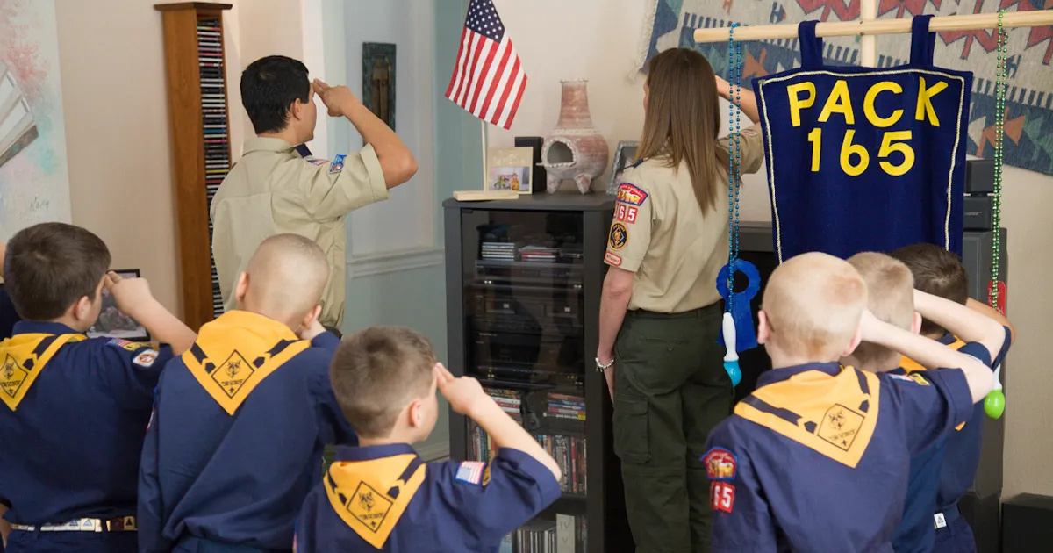
BEFORE SCHOOL STARTS

Slide 8

BEFORE SCHOOL STARTS (1)
Recruitment begins LONG before your sign-up night! Here are some things to check on now before the first bell rings:
  Unit Contact/Membership Contact Sheets
  Unit Calendars & 1-Sheets
  How to update your unit pin

Slide 9
BEFORE SCHOOL STARTS (2)
Recruitment begins LONG before your sign-up night! Here are some things to check on now before the first bell rings:
  PTO
  Outside Promo:
    Request to be on your school event mailing list
    Request to be at other events other than Open House
  Adopt-a-School

Slide 10
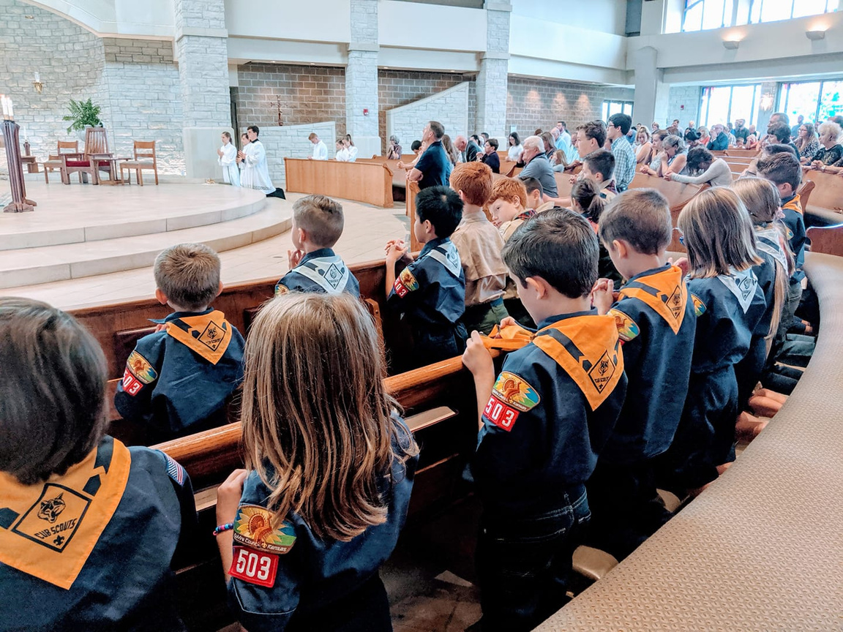
UNIT GOALS
How many youth do you NEED to recruit to be successful?

Slide 11
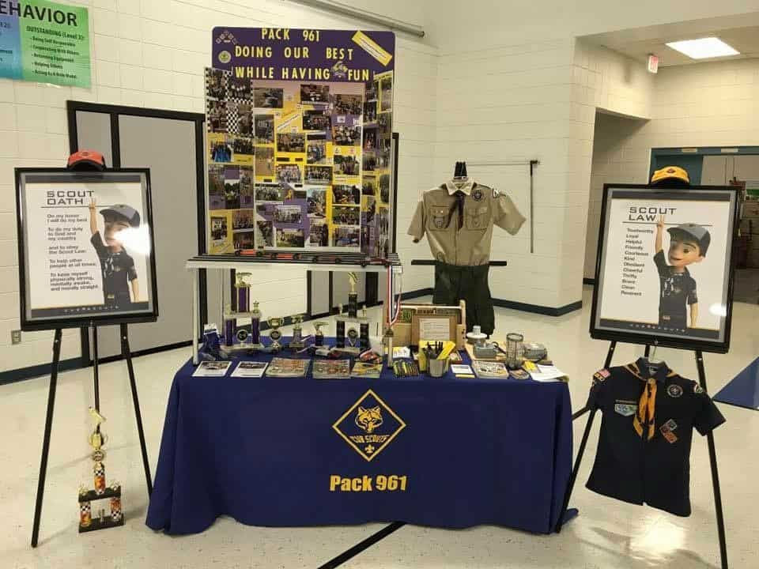
OPEN HOUSES

Slide 12
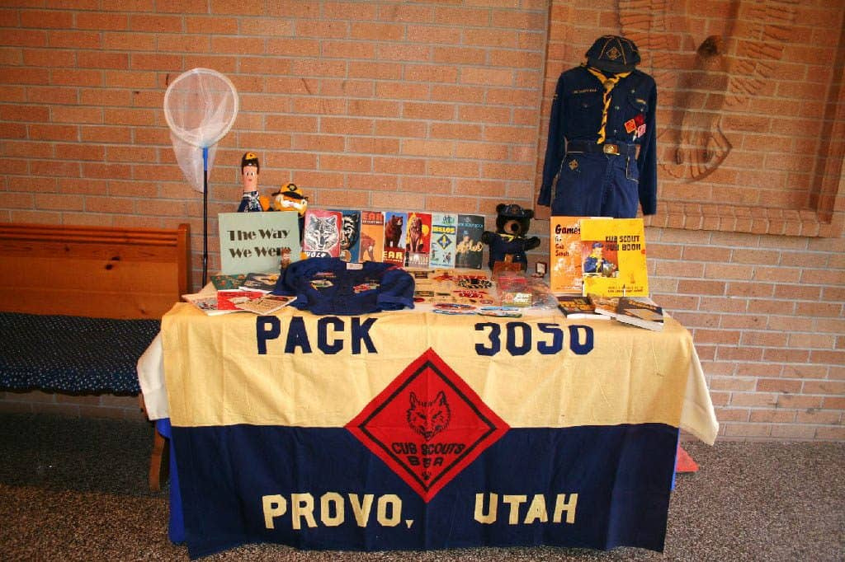
OPEN HOUSES (1)
Know your schools, know your dates!! BE THERE!!
  What do you need to have a successful recruitment even at an Open House? (Activity)

Slide 13
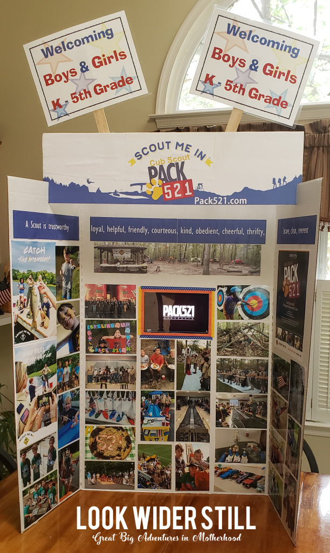
OPEN HOUSES (2)
Materials Checklist:
  Applications (English/Spanish)
  QR Codes
  Poster Board Display (if you have one)
  Scouting/Camping/Sports Table Cloth/Blanket
  Scout Lifes (Council has extra if you need!)
  Old PWD/Raingutter Regatta stuff
  Bow (if you have it)
  FUN!!! Showcase the program!!

Slide 14
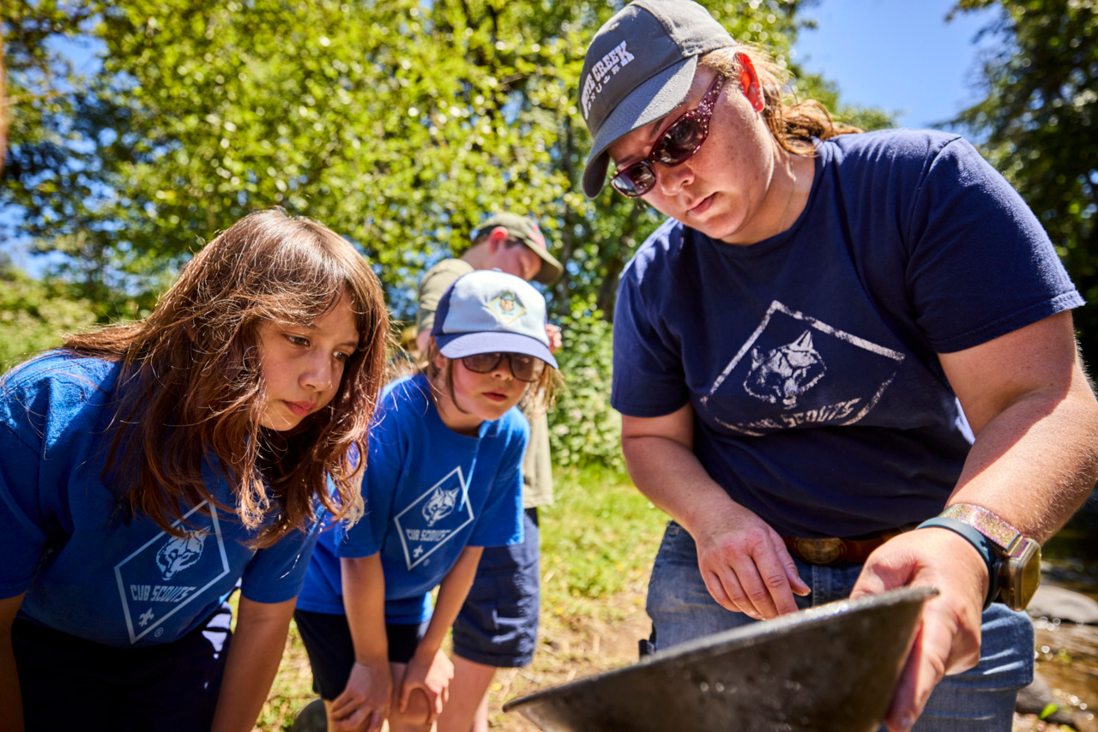
BEFORE
THE
RECRUITMENT

Slide 15
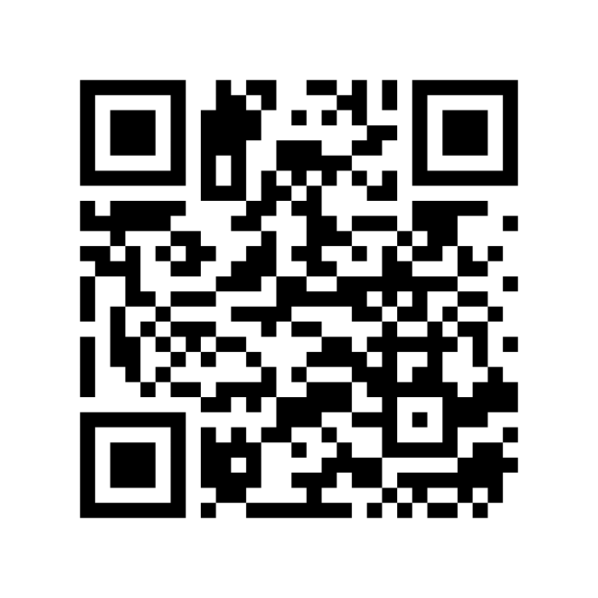
SEND US YOUR CALENDAR!
  This QR code links to a google form that you’ll fill out and let us know your upcoming events!

Slide 16
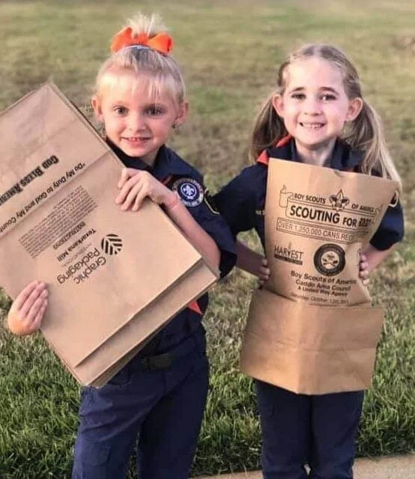
BEFORE THE RECRUITMENT
  Youth to Youth Invitations
  Social Media!!
  Communication (app game)

Slide 17
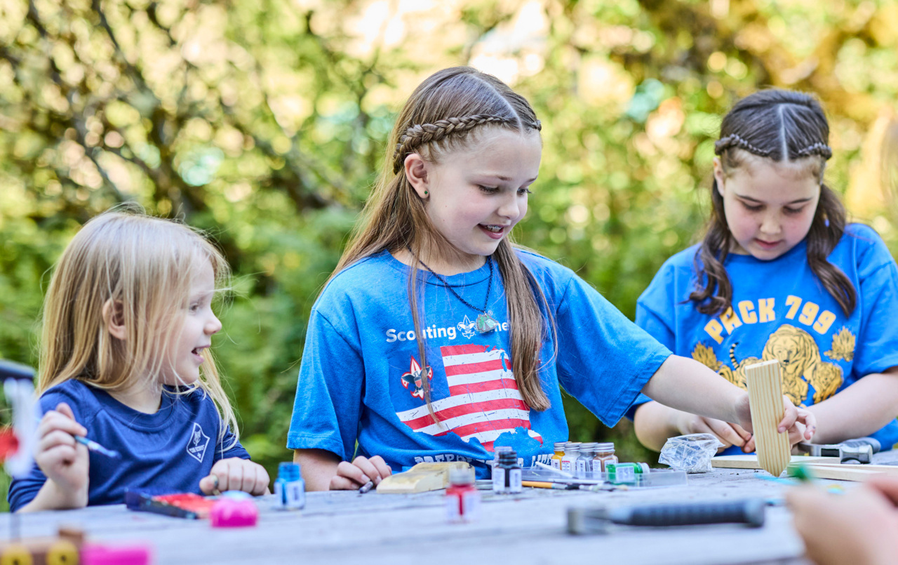
THE RECRUITMENT

Slide 18
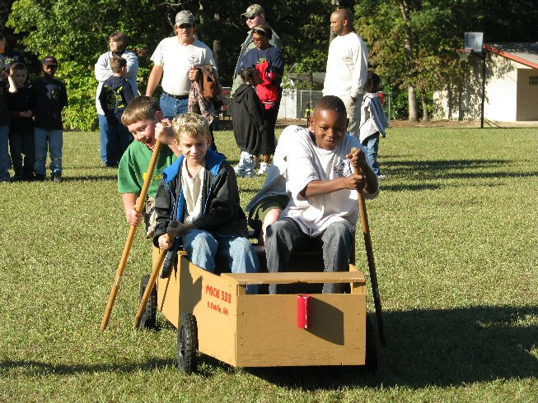
THE RECRUITMENT! (1)
  How to Have a Successful Sign-up / Recruitment / Scout Night (Handout)

Slide 19
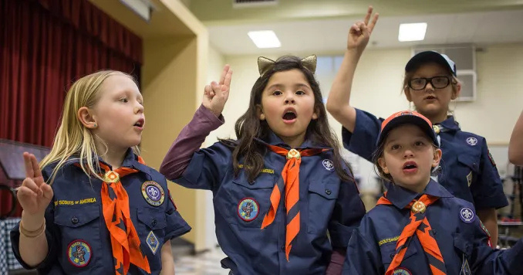
THE RECRUITMENT! (2)
  How to Have a Successful Sign-up!
  What to do during the event
  What NOT to do
  Making the ask!
  Using Digital tools

Slide 20

AFTER THE RECRUITMENT

Slide 21
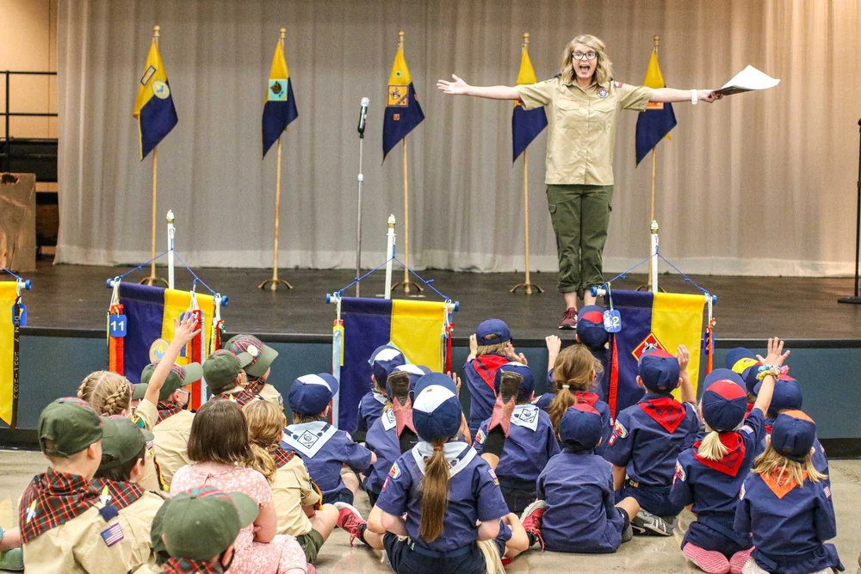
AFTER THE RECRUITMENT
  Nurture the relationship!
  Close your leads!
  Exit survey?

Slide 22
OTHER RESOURCES
  Make sure to put other resources here!!

Slide 23

Be ready for the BEAST!
  How big is this thing?
  Put it ALL on the line!
Notes:
-- How big is this thing? This thing being membership, of course. EVERY little thing you do matters, and it all adds up!
-- Put it ALL on the line. The next slide will go more into this detail, but membership season is big, and an annual make-or-break moment. Every little thing you do matters, and it matters a LOT.

Slide 24


01
07
12
WHY IS IT IMPORTANT TO HAVE FUN?
Scouts have fun with a purpose, don’t we?
How do we keep the fun going even when the kids are working on their requirements? How do we break the requirements up to have fun?
Notes:
Why is it important to have fun?
Scouting is fun with a purpose, after all! Why else would we say that if we weren't fun?
Cubs especially need the fun. On a Monday or Tuesday night after school, it's incredibly easy to lose their attention. Teachers have to already work dance breaks into their class time to keep them engaged. If you aren't doing that (or something similar), you're losing them.

Slide 25
OPEN FORUM:
DISCUSSION,
QUESTIONS, & SHARING
Notes:
Encourage attendees to ask questions, share their experiences, and discuss challenges and successes related to recruitment and retention.

Slide 26
TOPIC #1:
ORGANIZATIONAL TOOLS
QUESTIONS TO THINK ABOUT:
1. WHAT APPS OR TOOLS DO YOU USE TO KEEP YOUR UNIT ORGANIZED?
2. HOW DO YOU MANAGE INITIATED APPLICATIONS AND NEW LEADS?
3. WHAT SHOULD YOUR UNIT PIN INCLUDE?
Notes:
1. What apps or tools do you use to keep your unit organized?
2. How do you manage initiated applications and new leads?
3. What should your unit pin include?

Slide 27
TOPIC #2:
EVENT PLANNING
QUESTIONS TO THINK ABOUT:
1. WHAT ACTIVITIES DO YOU PLAN DURING THE SUMMER TO MAINTAIN ENGAGEMENT?
2. HOW DO YOU CREATE AND MANAGE YOUR UNIT'S CALENDAR?
3. HOW DO YOU KEEP MEETINGS FRESH AND FUN FOR NEW SCOUTS? (ARE WE HAVING FUN EVERY MEETING?)
4). WHAT ARE YOU DOING TO PREP FOR OPEN HOUSES IN THE FALL?
Notes:
1. What activities do you plan during the summer to maintain engagement?
2. How do you create and manage your unit's calendar?
3. How do you keep meetings fresh and fun for new scouts? (Are we having fun EVERY meeting?)
4). What are you doing to prep for open houses in the fall?

Slide 28
TOPIC #3:
RECRUITMENT STRATEGIES
QUESTIONS TO THINK ABOUT:
1. HOW DO YOU APPROACH OPEN HOUSES TO ATTRACT NEW YOUTH MEMBERS?
2. WHAT ELEMENTS DO YOU INCLUDE IN YOUR RECRUITMENT EVENTS TO MAKE THEM SUCCESSFUL?
3. WHAT CONTENT DO YOU INCLUDE ON YOUR UNIT'S FLYERS TO APPEAL TO POTENTIAL MEMBERS?
4. HOW DO YOU GENERATE AND FOLLOW UP ON NEW LEADS FOR RECRUITMENT?
5. HOW DO YOU INCLUDE THE 7 TOUCHES METHOD IN YOUR UNIT RECRUITING?
6. HOW DO YOU UTILIZE OTHER SCHOOL EVENTS IN YOUR RECRUITING?
(BE THERE! KNOW YOUR SCHOOL!)
Notes:
1. How do you approach open houses to attract new youth members?
2. What elements do you include in your recruitment events to make them successful?
3. What content do you include on your unit's flyers to appeal to potential members?
4. How do you generate and follow up on new leads for recruitment?
5. How do you include the 7 Touches method in your unit recruiting?
6. How do you utilize other school events in your recruiting?
(Be there! Know your school!)

Slide 29
TOPIC #4:
PARENTAL ENGAGEMENT
1. HOW DO YOU KEEP PARENTS ENGAGED IN THE PROGRAM?
2. WHAT STRATEGIES DO YOU USE TO RECRUIT PARENTS TO ASSIST OR TAKE ON LEADERSHIP ROLES? WHAT DO WE DO AFTER WE HAVE ASKED THEM TO ASSIST IN SOMETHING SMALL?
3. HOW DO YOU CHALLENGE YOUR PARENTS TO VOLUNTEER?
4. WHAT JOBS CAN YOU HAVE YOUR PARENTS DO TO ASSIST YOU DURING THE LEAD UP TO FALL RECRUITMENT?
Notes:
1. How do you keep parents engaged in the program?
2. What strategies do you use to recruit parents to assist or take on leadership roles? What do we do after we have asked them to assist in something small?
3. How do you challenge your parents to volunteer?
4. What jobs can you have your parents do to assist you during the lead up to fall recruitment?

Slide 30
TOPIC #5:
SELF-ASSESSMENT & IMPROVEMENT
QUESTIONS TO THINK ABOUT:
1. WHAT DO YOU CONSIDER YOUR UNIT'S WEAKEST POINT IN RECRUITMENT AND HOW ARE YOU ADDRESSING IT?
2. CAN YOU SHARE A SUCCESSFUL RECRUITMENT TACTIC THAT OTHERS MIGHT BENEFIT FROM?
3. WHAT IS YOUR FAVORITE PART OF BEING INVOLVED IN SCOUTING, AND HOW DOES IT MOTIVATE YOUR RECRUITMENT EFFORTS?
4. IYOS?
Notes:
1. What do you consider your unit's weakest point in recruitment and how are you addressing it?
2. Can you share a successful recruitment tactic that others might benefit from?
3. What is your favorite part of being involved in Scouting, and how does it motivate your recruitment efforts?
4. IYOS?

